Slide 1
CAS Applied Data Science
Module 4
Ethics, best practices and tools
PD Dr. Sigve Haug, sigve.haug@unibe.ch
2023-10-20

Slide 2
Why ethics and best practices ?
Data and code is almost everywhere, and poor data and code including documentation cost billions and maybe one day humanity.
Notes:
737

Slide 3
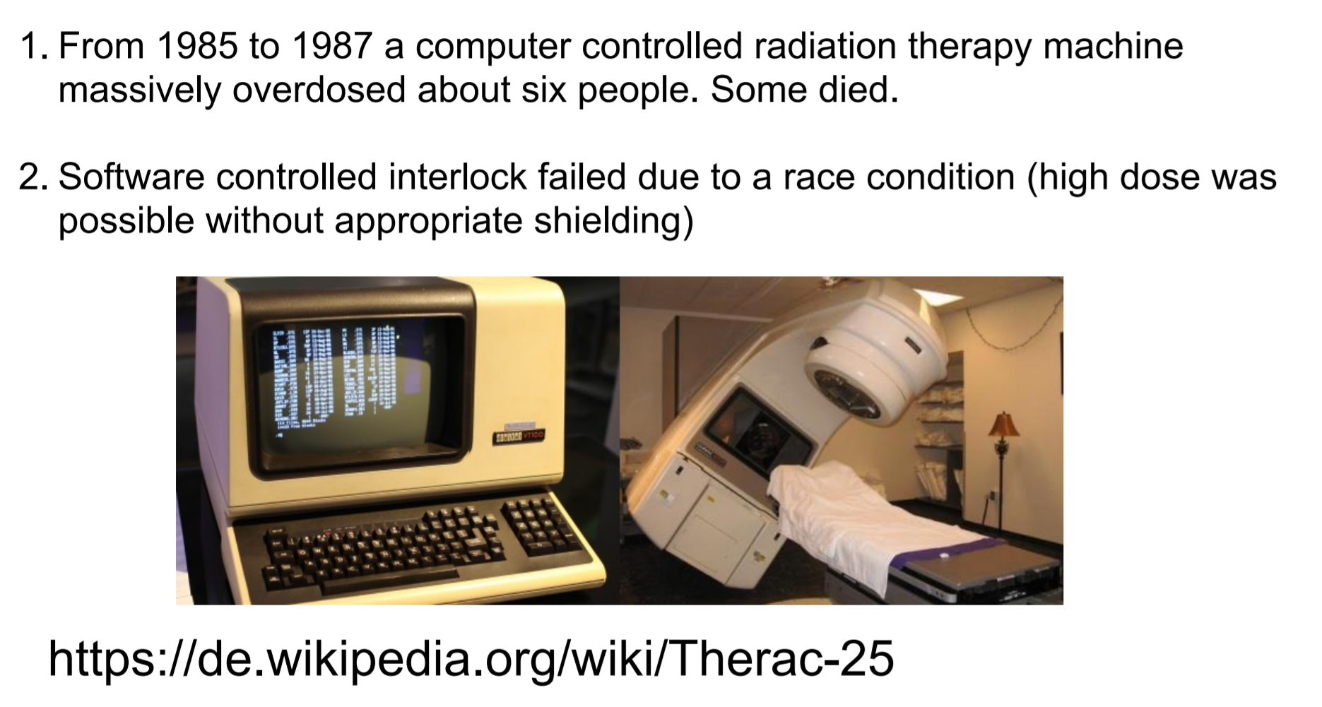
Therac-25

Slide 4
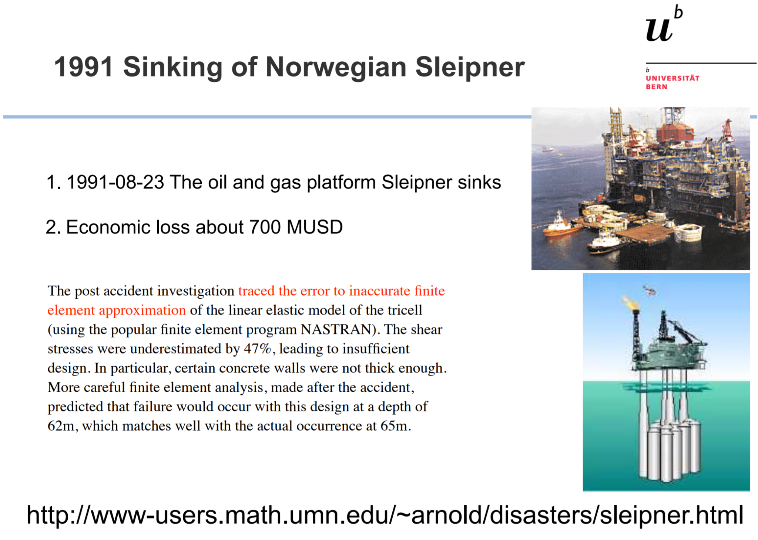

Slide 5
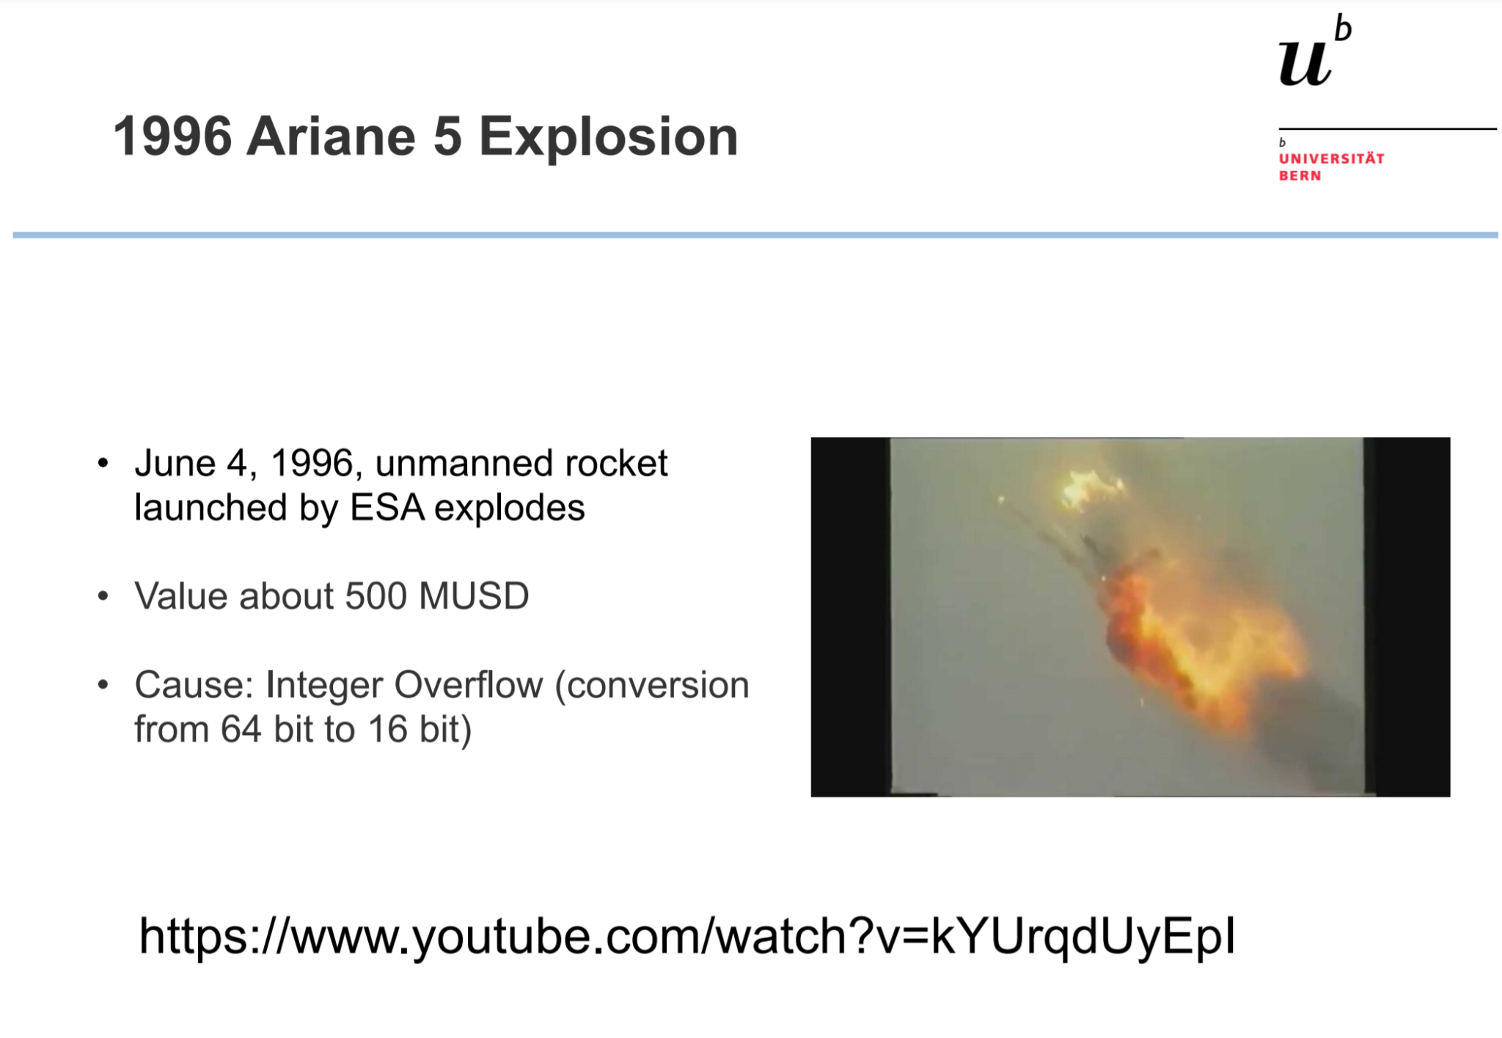

Slide 6
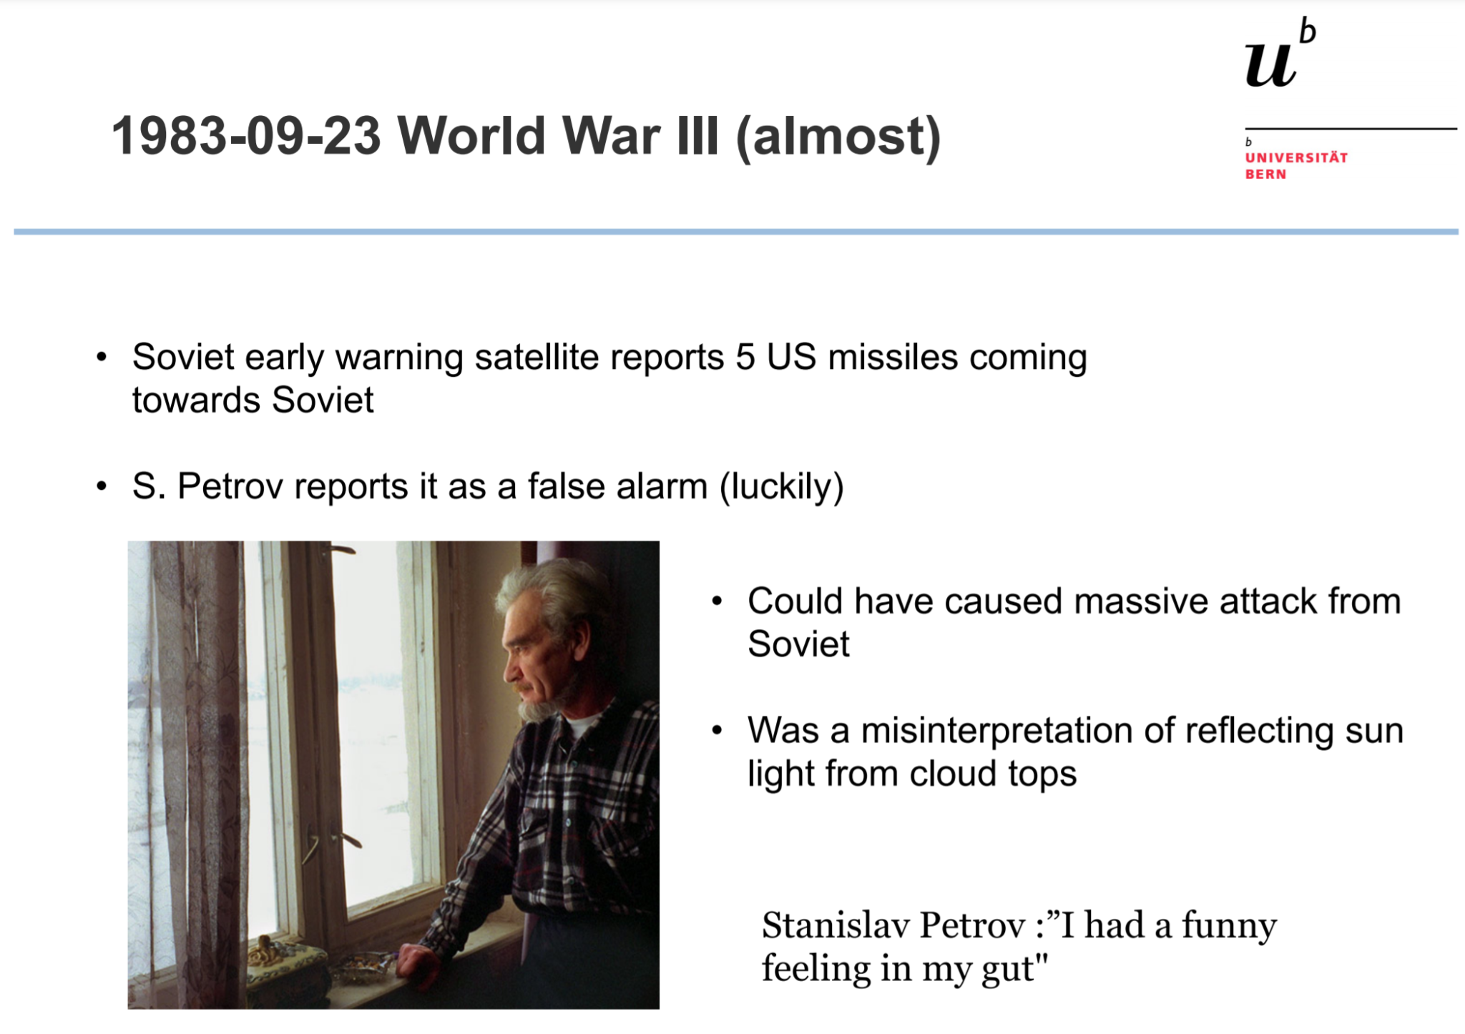

Slide 7
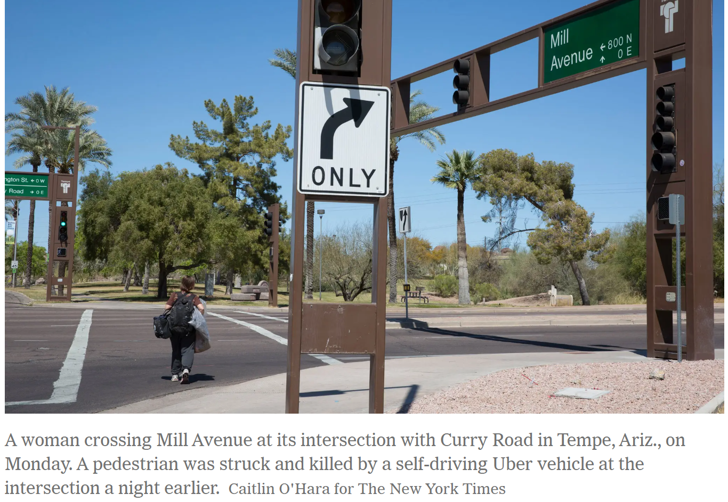
AI kills woman March 2019

Slide 8
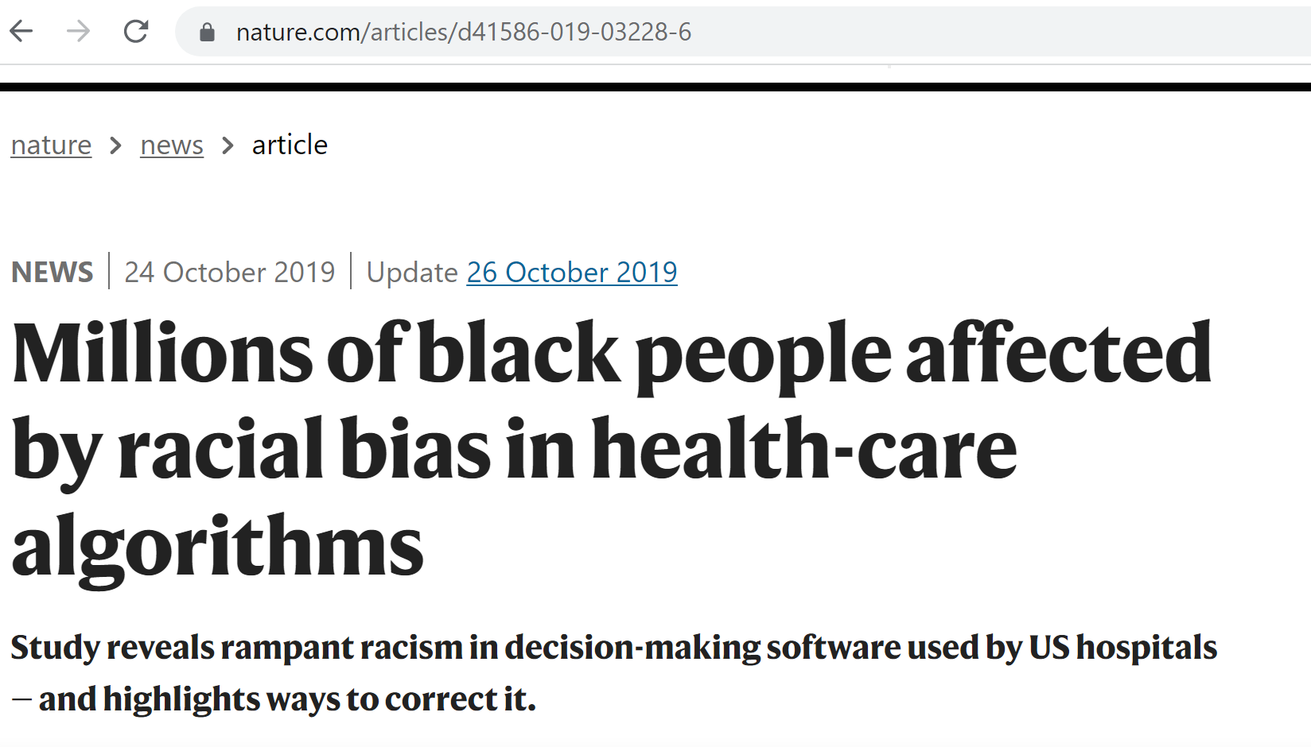
Racial Bias in AI

Slide 9
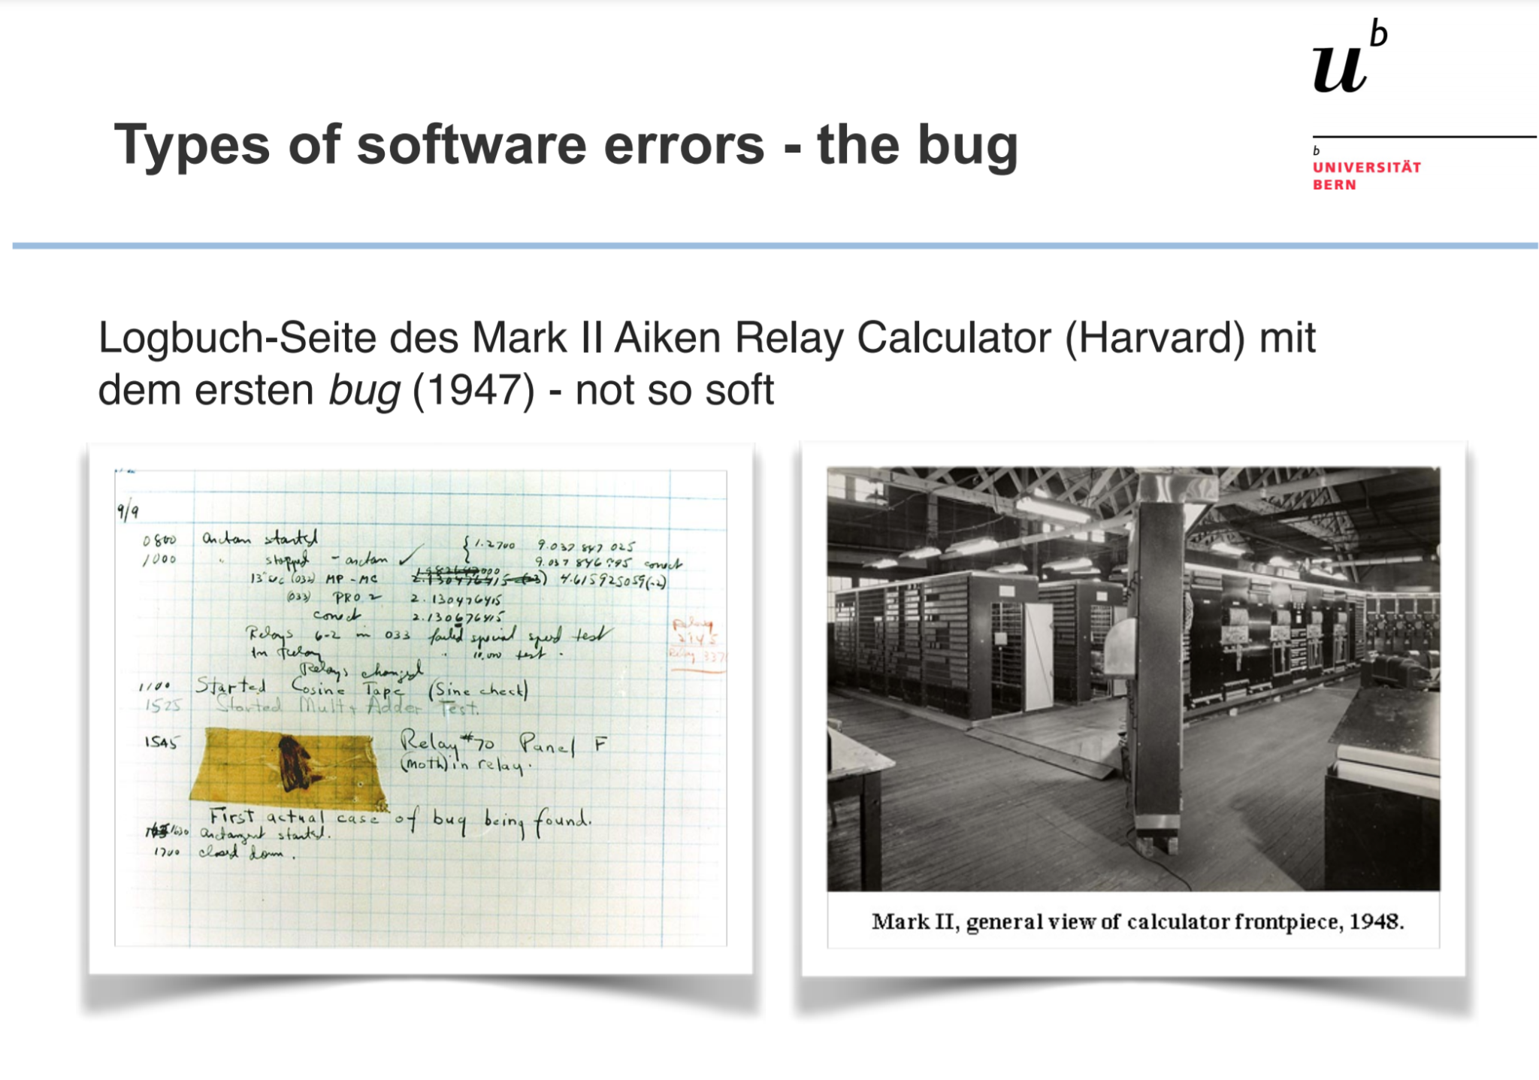
Objectives and steps
The Emergence of the Bug

Slide 10
What can we do about it ?
Conduct ethically
Do the right and not the wrong thing when doing our data science
Implies a choice
What is the right thing ?
Often respecting the law and the regulations
Perform your work respectfully to the resources of the planet, including animals and other colleagues
Notes:
737

Slide 11
International “Standard”
Data, code and other stuff should be FAIR
Findable
Accessable
Interoperable
Reproducible
Fortunately there are commonly accepted Best Practices and Tools to help us being FAIR and ethical
Notes:
737

Slide 12
Module 4
2023-10-20 Best practices and Documentation (half day - today)
2023-10-27 Cyber Security (full day)
2023-11-03 Git 1 (half day)
2023-11-10 Git 2 (half day)
2023-11-17 FOSS (half day)
2022-11-30 Deadline for module project (github repo)

Slide 13
Some Best Practices

Slide 14
Data Science Project - typical pipeline
1 Objective / research / business case formulation (CDR)
2 Data acquisition
3 Data cleaning / preprocessing
4 Feature engineering
5 Modelling
6 Results and evaluation
7 Presentation and publication
8 Production
Notes:
737

Slide 15
Best Practices (BP) - Teamwork
You are assigned to 1 of 8 breakout rooms
Room number defines the BP number in the article on Ilias to present (1 slide)
Each room/team also considers and presents 1 slide on best practices on their pipeline number
30 minutes teamwork
Each team has 3 minutes for their presentation (2 slides) (starts at 10:00)
Write your slides here !
Notes:
737

Slide 16
Documentation (11:00-12:00)
Levels
Good variable and method/function names
Inline comments / docstrings (in, out, what it does)
Readme files
wiki pages
Static webpages (automatically generated)
Manual (pdf)
Book
Notebooks
Use VCS (Git)
Notes:
737

Slide 17
Tutorial - Inline and README
I will use my terminal and the nano editor on my MacOS. Windows users can use powershell, or better a terminal from Anaconda. You can also use an Integrated Development Environment (IDE) like Visual Studio, PyCharm or Spyder. A third option is subscribe to colab pro for 10 CHF per month. It provides a terminal.
# Linux cheat sheet
# https://cheatography.com/davechild/cheat-sheets/linux-command-line/
# One simple editor is nano. If you don’t have it, you can install it.
apt-get install nano
# I will now write a python script and document it with inline comments and a README file.
nano perfect-numbers.py
python perfect-numbers.py
nano README.md
Notes:
737

Slide 18
Tutorial - Webpages with Sphinx
Sphinx (and other tools)
Generates webpage documentation of your project from Markdown files
Files lives together with code in a doc/ subfolder
When used with git, code and documentation are synchronised
When pushing the project to GitHub, ReadTheDocs can automatically update its public webpages
This kind of documentation is rather for larger projects. If you want to practice it, you can do so in the module project (instructions), however, this is not mandatory.
Notes:
737

Slide 19
More on Documentation
https://coderefinery.github.io/documentation/
Notes:
737

Slide 20
Bias in Data Science
https://www.youtube.com/watch?v=PWCtoVt1CJM
Notes:
737

Slide 21
12:00 - 12:20 Q&A

